Slide 1

GUI-Based Student Information System
Using Java Swing for Modern Education Management

Slide 2

Why This System Matters
The Problem
Who Needs It
Many schools and colleges still use paper-based systems or basic spreadsheets to track student information. This creates confusion, errors, and wasted time searching through files.
High schools and colleges
Administrative staff
Teachers and counselors
IT departments
Without a centralized system, important data like grades, attendance, and contact information gets scattered and hard to manage.

Slide 3



How the System Works
The system connects three main parts to create a complete solution for managing student data.
Graphical User Interface
Logic Layer
Data Storage
Buttons, forms, and menus that users click and interact with
Processes commands and manages data operations
Saves all student information to files

Slide 4
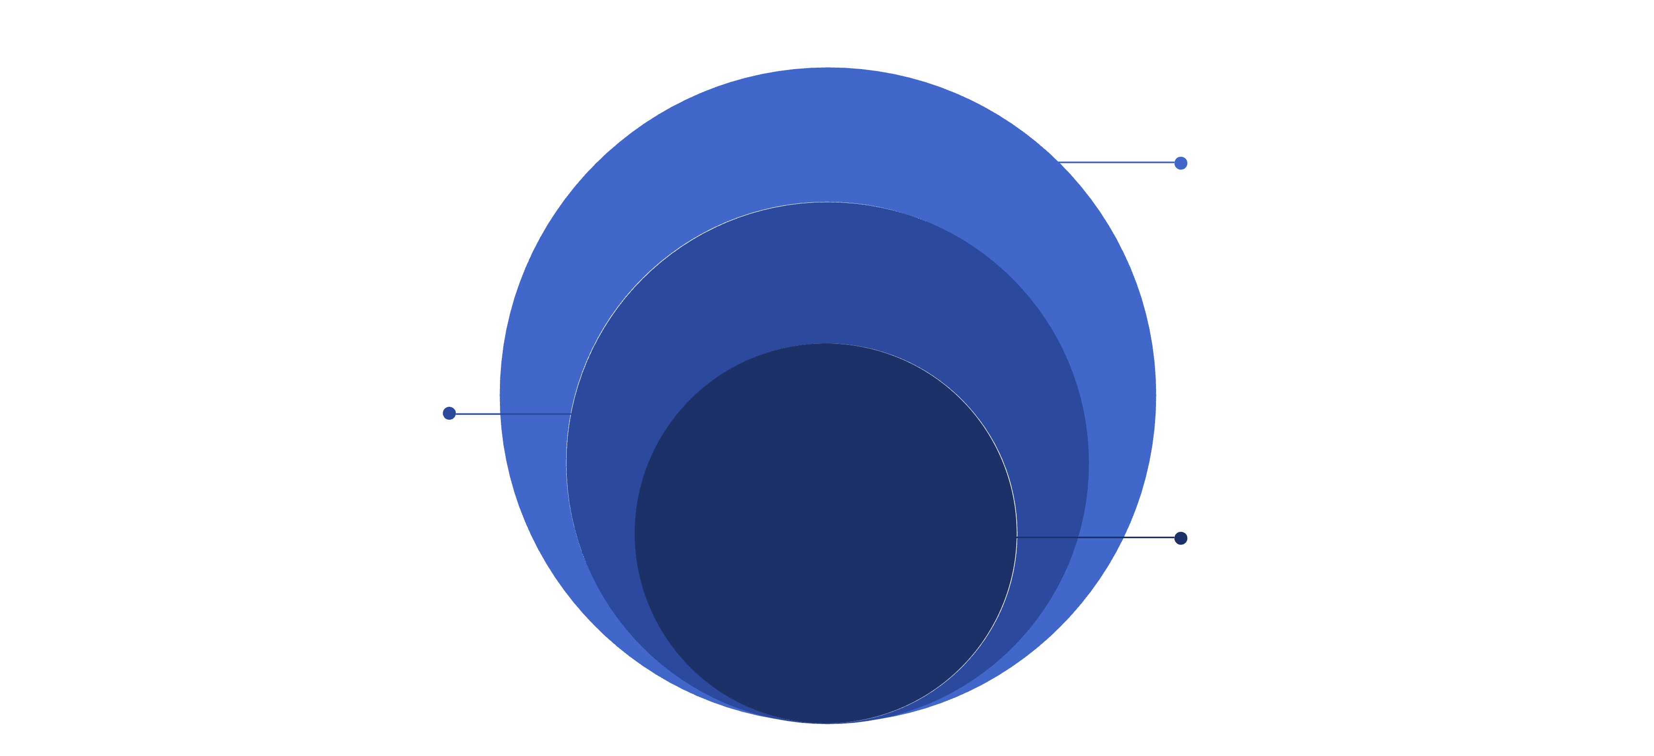
System Architecture Diagram
Data Storage
Databases and persistent storage systems
Logic Layer
Business rules and application processing
GUI Layer
User interface and interaction points

Slide 5




Building Blocks: Key Classes
Student Class
StudentUI Class
Holds all student details like name, ID, grades, and contact information
Creates the windows and buttons that users see and click
StudentManager Class
FileHandler Class
Handles adding, searching, and updating student records
Saves and loads data from the computer's hard drive

Slide 6
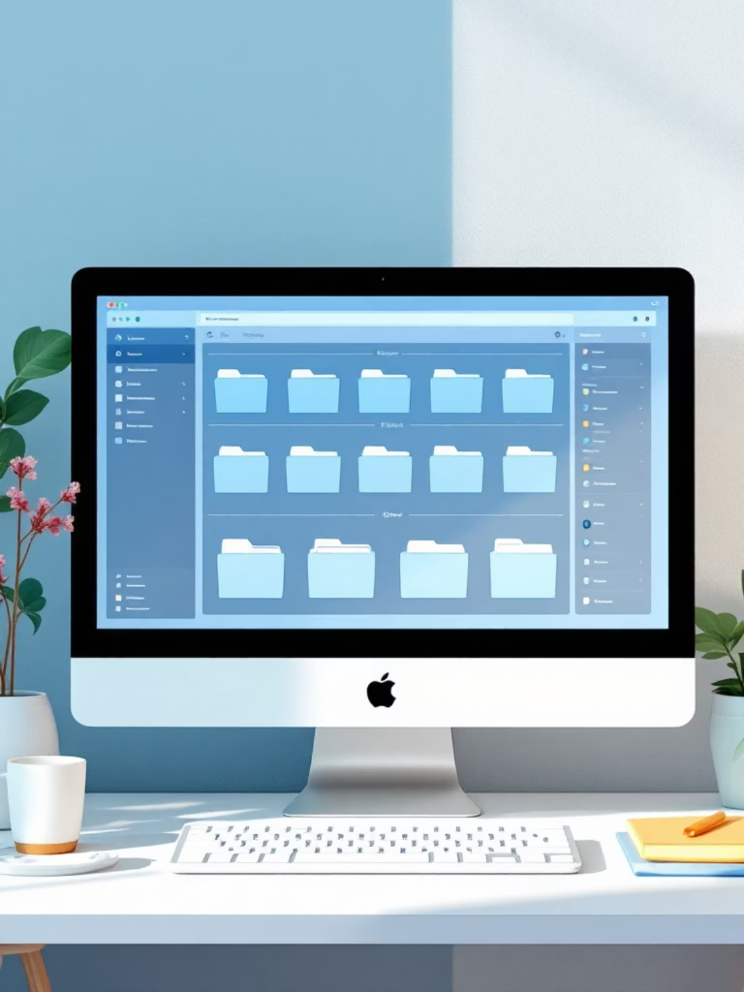
Package Structure
com.student.system.ui
com.student.system.model
com.student.system.utils
User interface components, windows, and forms
Student data structure and related classes
File handling and data management tools

Slide 7
Object-Oriented Programming Concepts
These programming principles make the system easier to build and maintain.
01
02
03
Abstraction
Inheritance
Polymorphism
Hides complex details behind simple interfaces. Users just click buttons without knowing how data is stored.
Child classes reuse code from parent classes. For example, different types of users can share common features.
Same method name works differently based on context. Search works the same whether finding by ID or name.

Slide 8
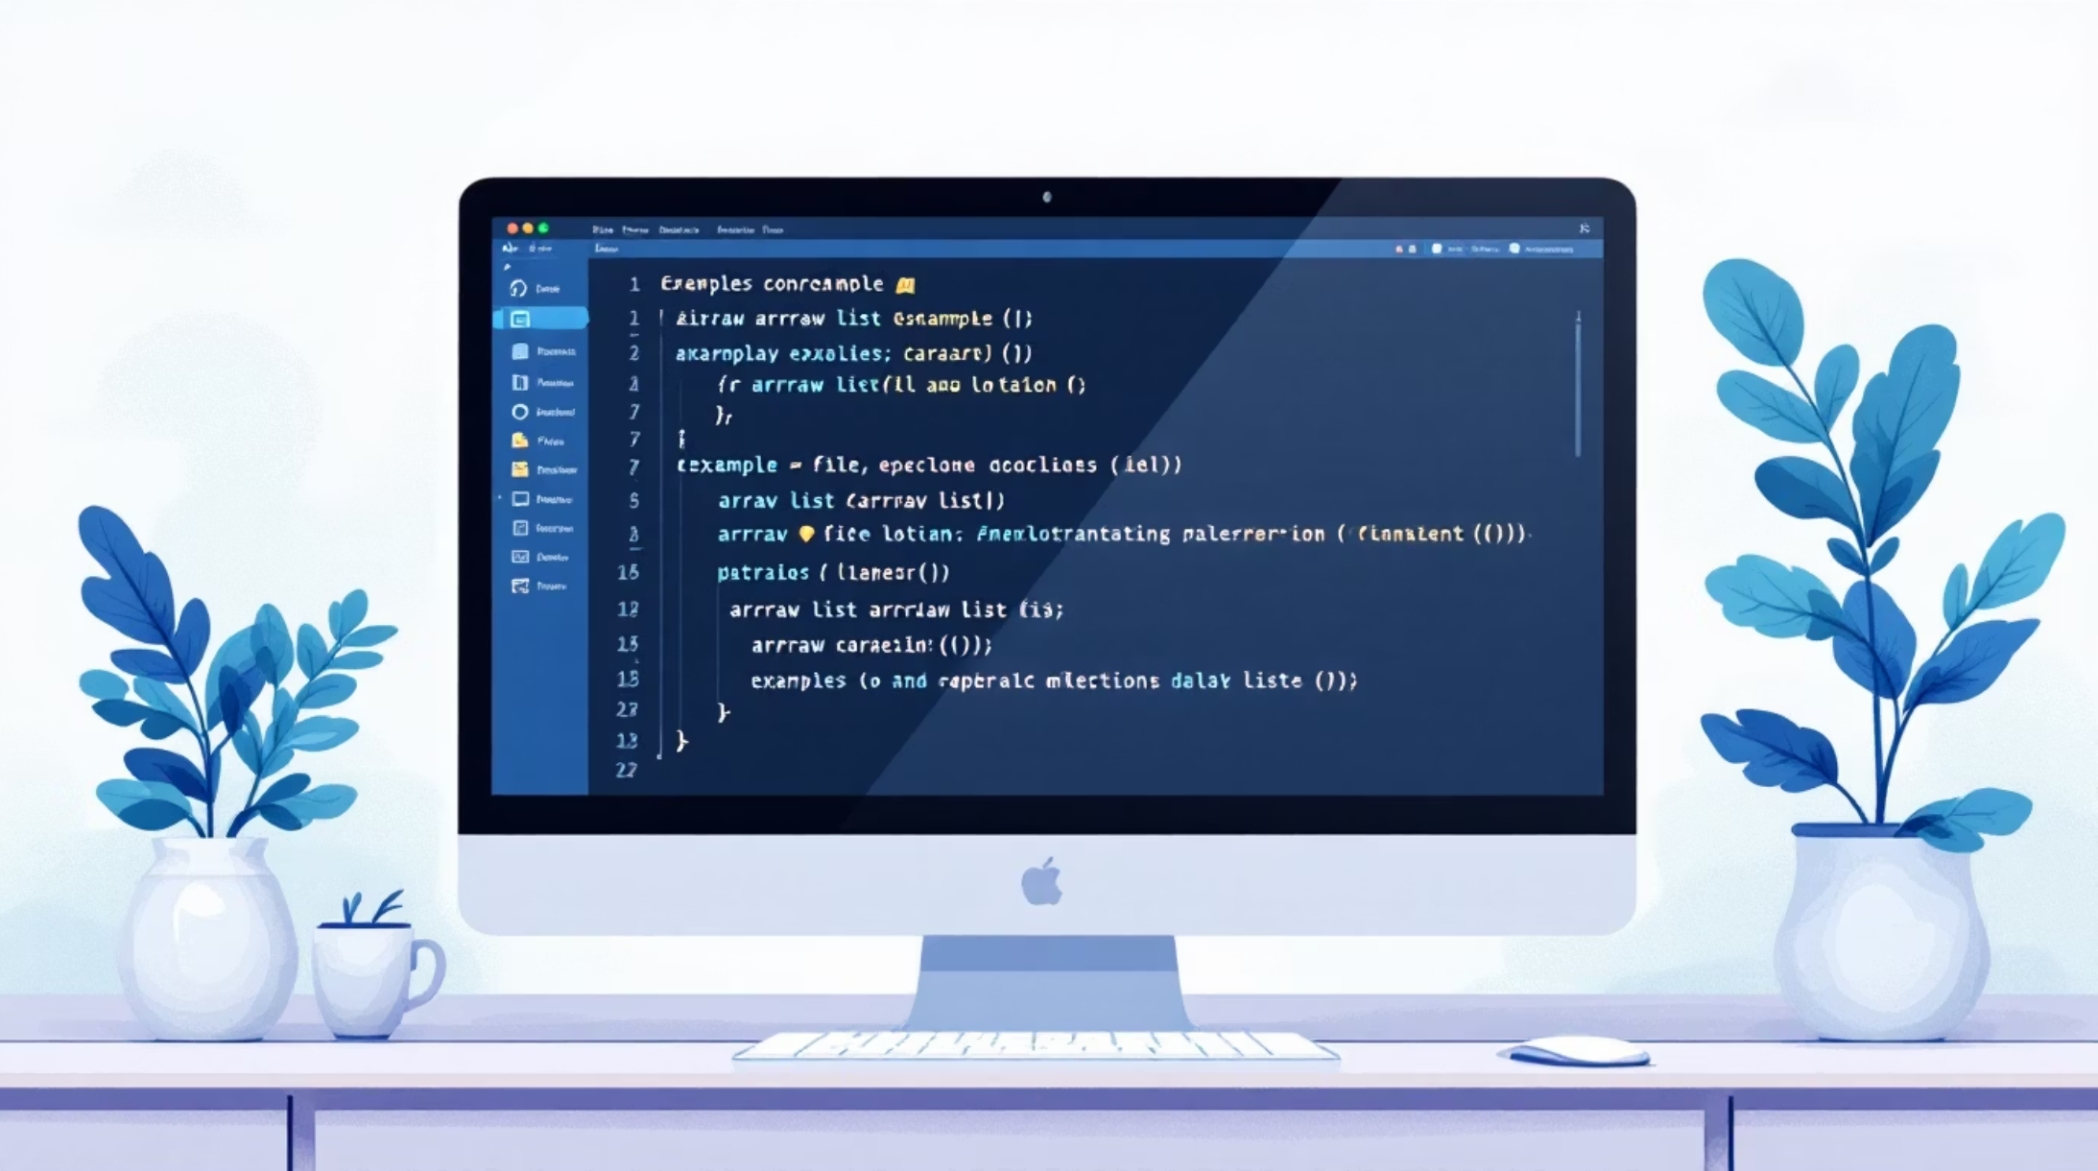
Design Decision: ArrayList + File Handling
Why This Approach
We chose ArrayList to store student data in memory because it's simple to use and automatically adjusts size as students are added or removed.
File handling saves data to a text file on the computer, making it persistent even after closing the program.
Benefits
No database software needed
Easy to understand and implement
Works on any computer
Quick to set up and test

Slide 9
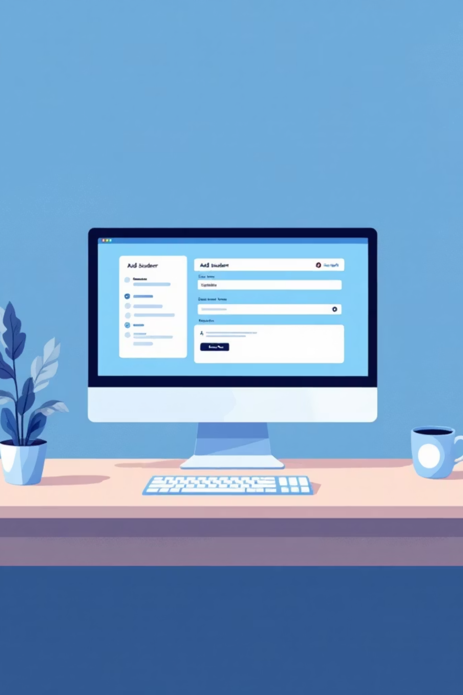
How It Works: Step by Step
Add Student
Fill out the form with student details and click Save. The system checks for missing information and adds the record.
Search for Student
Enter a student ID or name and click Search. The system looks through all records and finds matches.
Display Results
View all student information in a clean, organized table format on the screen.

Slide 10

Error Handling Example
What Happens
When a user tries to add a student without entering a required field like name or ID, the system stops the action and shows a helpful message.
Why It Matters
This prevents incomplete or incorrect data from being saved, keeping the student database accurate and reliable.
Key Takeaways
Simple & Intuitive
Reliable
Portable
Easy for anyone to use, no technical skills needed
Validates data and prevents errors
Works without extra software or internet

